Slide 1
Installation Guide
(Eclipse Plug-in – Spring IDE)
2008. 12. 15
CODELABOR
Shin Sang Jae (codelabor@gmail.com)

Slide 2
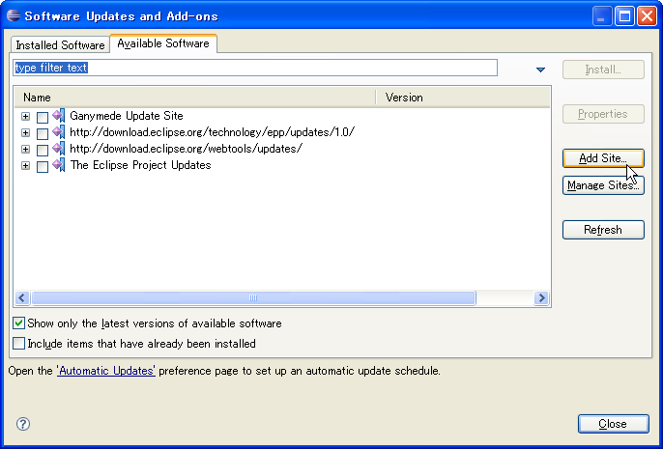
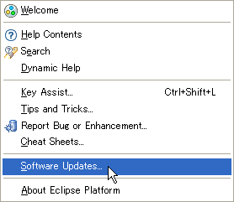
Spring IDE
Update
Eclipse Spring plug-in
Officical Site: http://springide.org/blog/
Eclipse update site URL: http://springide.org/updatesite

Slide 3
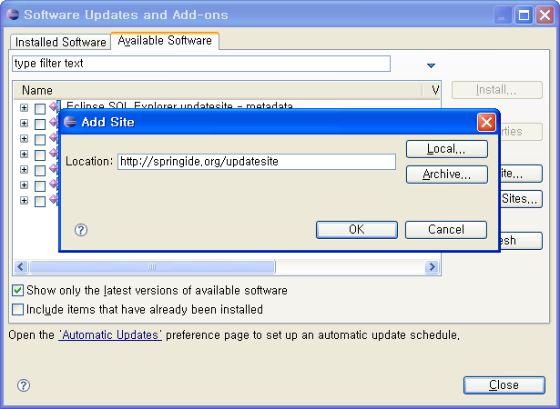
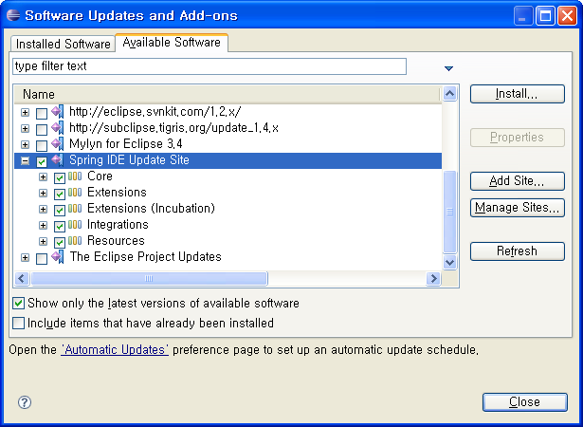
Spring IDE
Add Site
Site Location: http://springide.org/updatesite

Slide 4
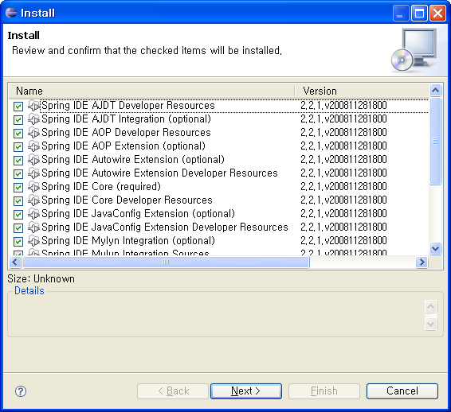
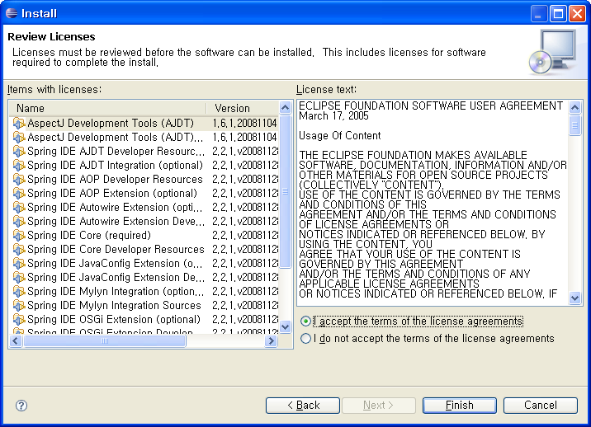
Spring IDE
Add Site

Slide 5
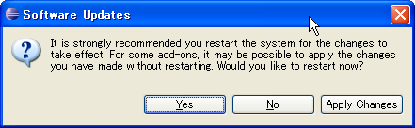
Spring IDE
Preference
Restart Eclipse or Apply Changes

